Slide 1
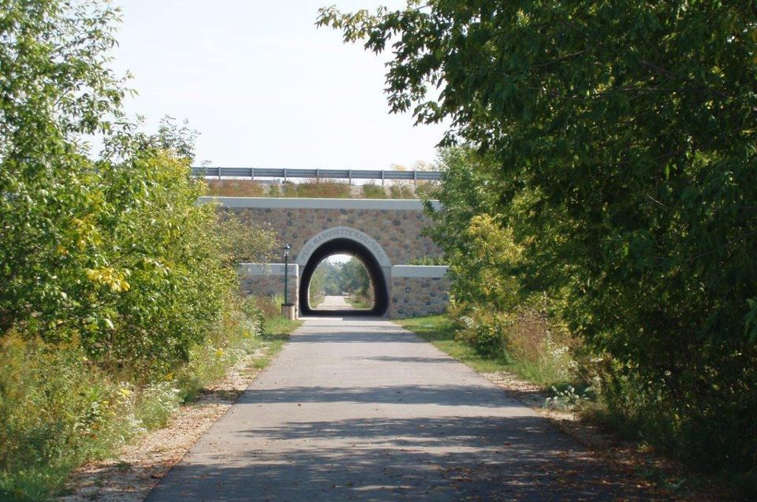
THE PERE MARQUETTE RAIL-TRAIL
EXTENSION - DEVELOPMENT PROJECT
(FIXING THE “GAP”)

Slide 2
THE CLARE “GAP”
This project will complete the non-motorized “gap” that exists between the Pere Marquette Rail-Trail East Trail and the Pere Marquette West Trail in the City of Clare and Clare County.
The completion of the Clare “gap” will create an 86-mile continuous non-motorized network that will connect the City of Midland to the Village of Baldwin.

Slide 3
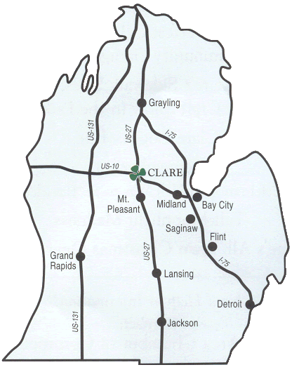
PROJECT LOCATION

Slide 4
SITE PLAN

Slide 5
SITE PLAN

Slide 8
4th Street/Pine Street

Slide 9
4th Street/McEwan Street

Slide 10
FUTURE RAIL CROSSING

Slide 11
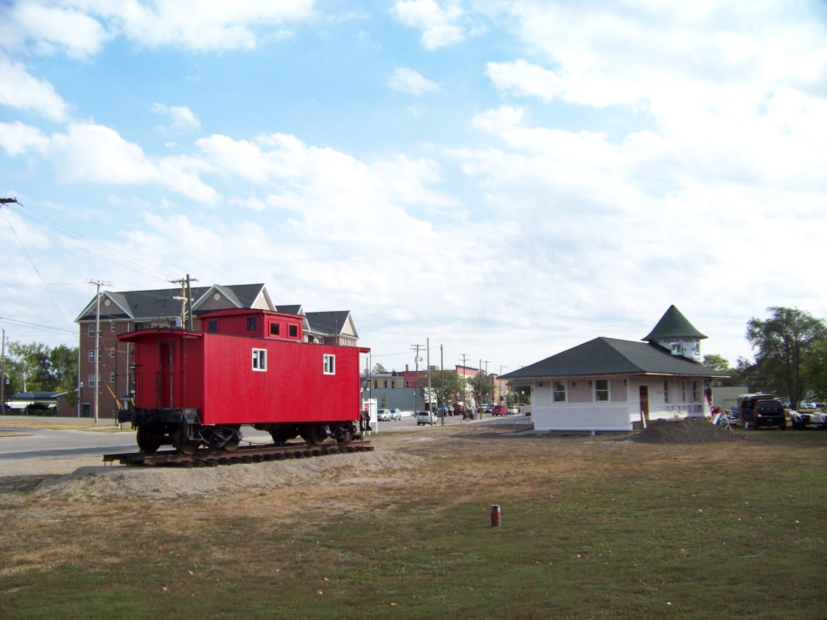
THE CLARE HISTORICAL DEPOT

Slide 13
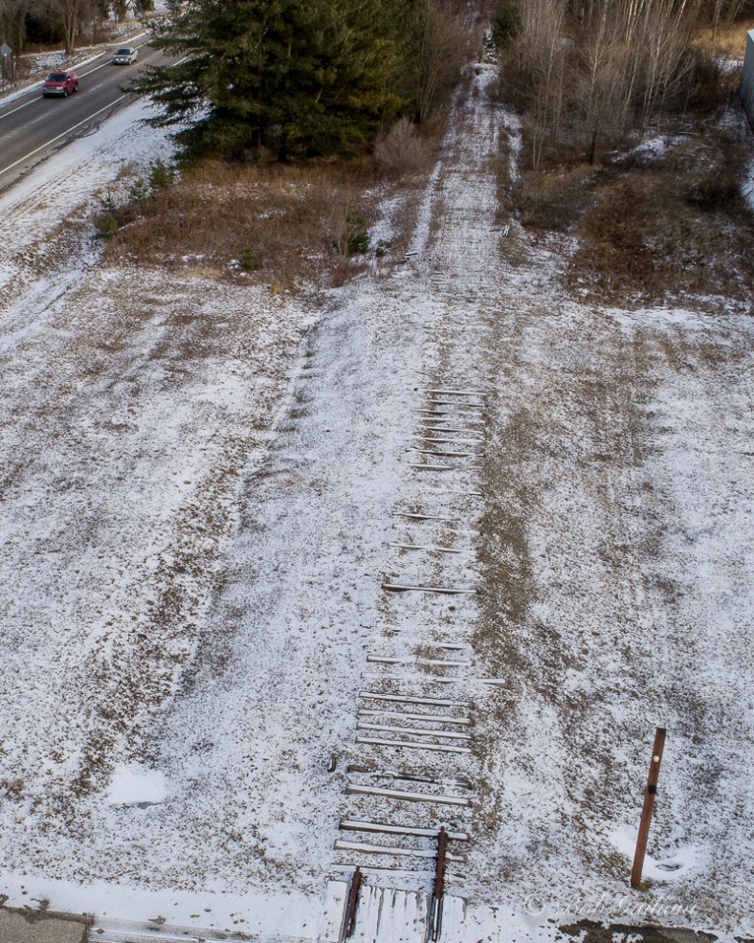
RETIRED RAIL AND M-115

Slide 14
FOOT BRIDGE

Slide 15
This project has been a collaborative effort between the City of Clare, the Michigan Department of Transportation, and the Michigan Department of Natural Resources. However, we have received overwhelming support from other community businesses and organizations, including…

Slide 16
Clare County Conservation District
Clare County Sheriffs Department
Clare County Veterans Affairs
Clare Depot Committee
Clare-Gladwin Regional Education Service District (CGRESD)
The Forsberg Family
FRIENDS of Clare County Parks and Recreation
FRIENDS of Garfield Township Parks
Isabella County Parks and Recreation
Jaynie Hoerhauf
Little Forks Conservancy
Medilodge
Michigan Trails & Greenways Alliance
Mid Michigan Community Action Agency (MMCAA)
Mid Michigan Community College
Mid Michigan Industries (MMI)
Middle Michigan Development Corporation
Michigan Recreation & Park Association (MPARKS)
MSU Extension

Slide 18
THANK YOU FOR YOUR SUPPORT OF THE PERE MARQUETTE RAIL-TRAIL EXTENSION - DEVELOPMENT PROJECT

